Slide 1
2023 Summer Workshop 2 Partnerships and Sales
7/12/2023

Slide 2
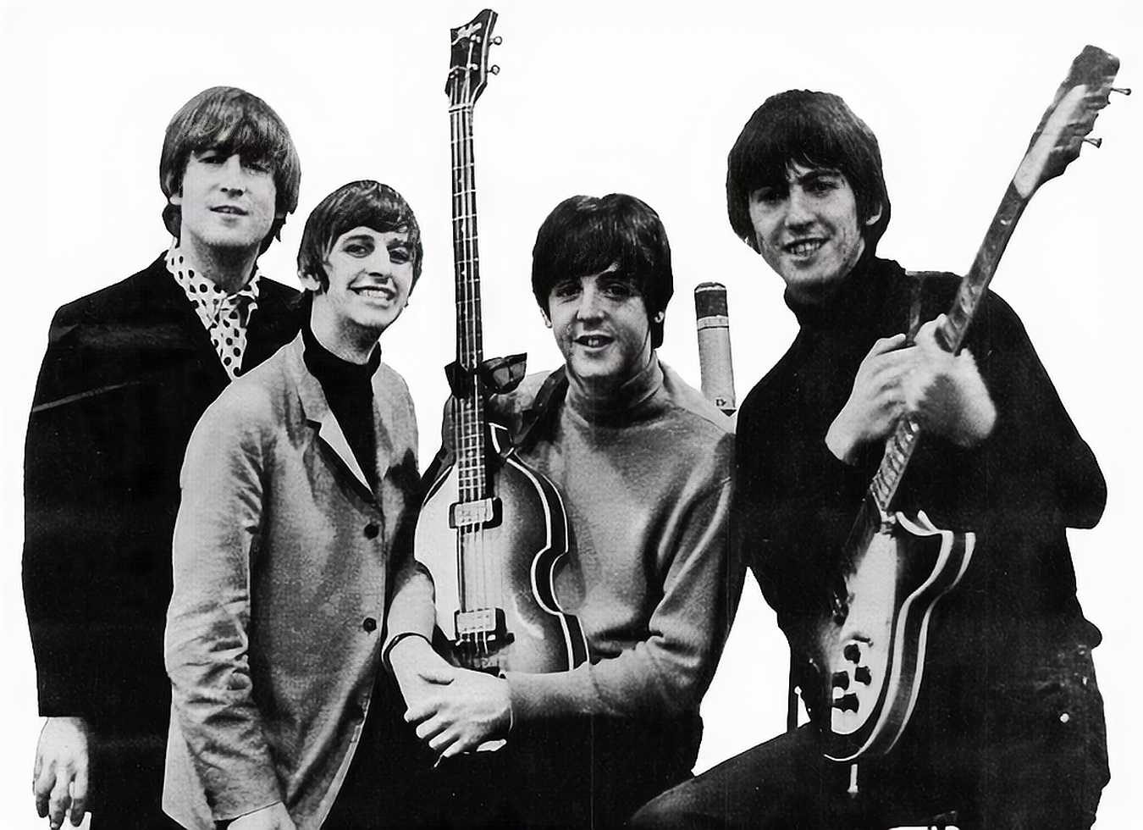
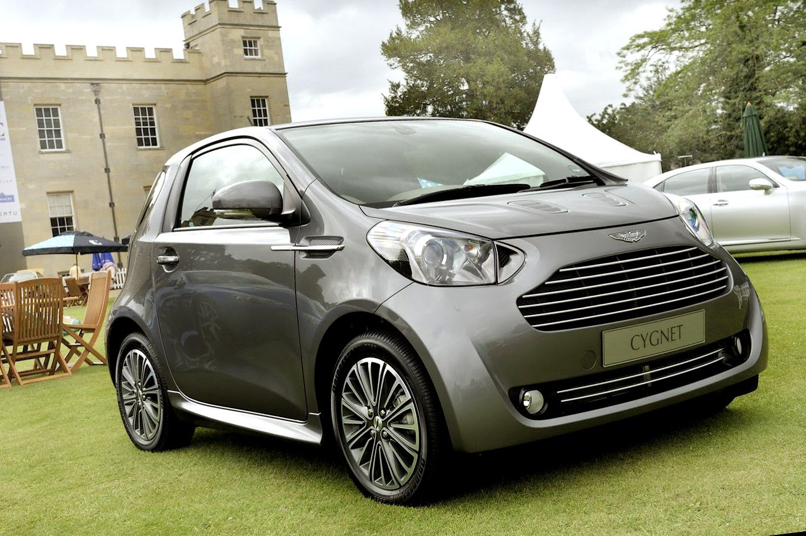
What is a Partnership?

Slide 3
What is a Partnership (for a Startup)?
A startup partnership refers to a collaborative relationship between two or more startups or between a startup and an established company. These partnerships aim to leverage each other's resources, expertise, and networks to achieve mutual growth and success.

Slide 4
Types of Partnerships
Strategic Partnerships: Collaboration between startups and established companies to achieve a specific strategic objective
Supplier or Distribution Partnerships: Partnerships focused on the supply chain, distribution channels, or manufacturing processes
Investment Partnerships: Partnerships where established companies invest in startups, providing funding and resources
Research and Development (R&D) Partnerships: Collaborations aimed at advancing research and development efforts
Incubator or Accelerator Partnerships: Partnerships between startups and incubators/accelerators to provide support, mentorship, and resources

Slide 5
Discussion 1: Your Partnership
For 10 minutes, let's talk about partnership ideas or experiences.

Slide 6
Examples of Partnerships
Strategic: Joint product development, co-marketing campaigns, strategic alliances, technology licensing agreements. Examples: Google, IBM
Supplier or Distribution: Supplier agreements, distribution partnerships, contract manufacturing arrangements. Example: Microsoft, Arrow
Investment: VC investments, corporate venture funds, angel investor partnerships, venture studios. Examples: Canon, NLC
Research and Development (R&D): Co-development projects, joint research initiatives, technology transfer agreements. Example: IBM, AWS, Google, Microsoft, Hamamatsu
Incubator or Accelerator: Startup incubator programs, accelerator partnerships, shared workspace collaborations. Example: Google

Slide 7
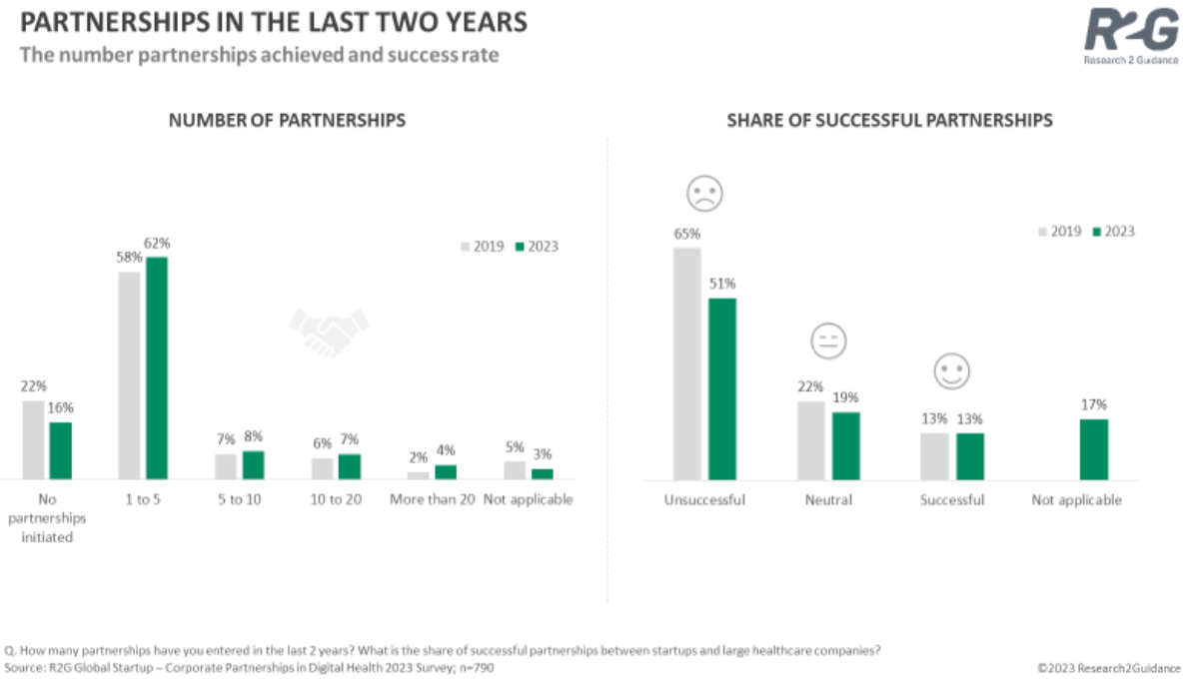

Slide 9
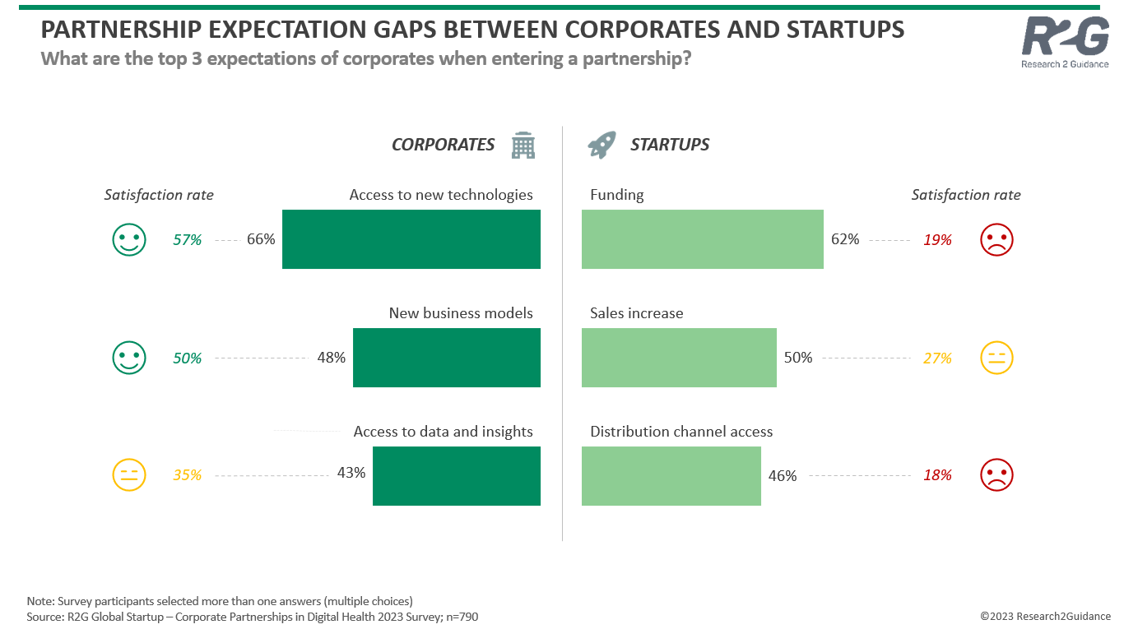

Slide 10
Discussion 2: Takeaways
For 10 minutes, let's discuss the main takeaways as they apply to your projects.

Slide 11
Q&A

