Slide 1
Demand Validation for B2C Ventures
Understand the problem
Test the solution
Spring 2024
Notes:
Speaker: Kim
Speaking Notes:
Thank you all so much for joining us.
I would like to introduce our Executive Director, Matt Segneri. Matt – take it away!

Slide 2
Why do great products fail?
Bottom line: it's a nice to have, not a must have.
It doesn't address a real need in the market. (Harley-Davidson Perfume)
It's ahead of its time. (Too expensive, bulky technology – Google Glass)
Targeted the wrong customers. (Segway- targeted general market vs niche usage occasions)
Changing behavior is hard. (When was the last time you downloaded a new app and used it frequently a year later?)

Slide 3
Think about your venture….
If it fails, will it be
1) A technological/development failure?
or
2) A Marketing failure?

Slide 4
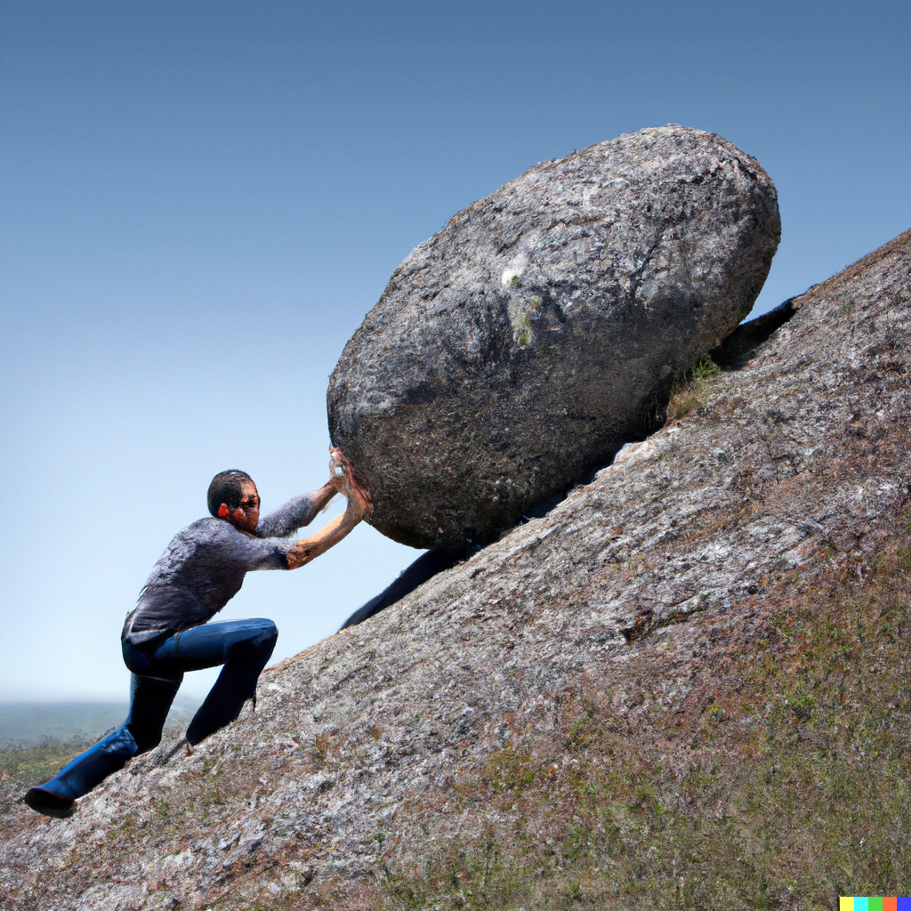
Why Ventures Fail (What Not to Do)
#1 reason: lack of customer demand
A product that doesn't solve a key problem for customers.
You’re targeting the wrong customer
It takes a lot of effort to make each sale. It costs more to acquire customers than each is worth (with no path to reducing cost).
Running out of money and time...
What to do instead? Validate Demand
Understanding your customers' needs and pain points (e.g. by interviewing customers ideally before you start building) so that you're more likely to build a product or service that they will love.

Slide 5
Key to Success (launch or not launch)
Become and expert in the problem you’re trying to solve
“Good Founders love the solution; Great Founders love the problem”
“Not all great solutions are great businesses”

Slide 6
Entrepreneurial Journey (customer validation iterations)
Identify a Problem
Customer discovery
Build MVP
Secure first customers / pilots
Customer generation & traction
Achieve PMF
Scale the business
(Customer interviews)
(No Code / Low Tech)
Customer Validation / Pivot
(iterate until customers stick around and pay)

Slide 7
Agenda
Customer discovery
Validate your solution

Slide 8
Step 1: Customer Discovery (mastering the problem and the people it affects)

Slide 9
Goals of Customer Discovery
Become an expert in the problem! Learn about customers’ perception of the problem that your product solves:
How do they view the problem, how big a pain?
Are they actively trying to solve it?
How do they currently solve it?
Evaluate the viability of your idea: is there sufficient need? How many people might have this problem?
Identify the right target customers: who are the customers with the greatest need? This is your first customer, not necessarily your long-term target customer
NOT goals of customer discovery
Get them to "validate" your idea - Don't trust the yes's.
Get them as a customer - that can turn your interview into a sales pitch, and you miss out on valuable learning about your customers and their needs.

Slide 10
Mom Test
Dos and don'ts of interviewing customers
The Mom Test: How to Talk to Customers & Learn If Your Business Is a Good Idea When Everyone Is Lying to You
by Rob Fitzpatrick

Slide 11
Interview Exercise
Idea for an attachment to a razor so you don’t cut yourself shaving
Need volunteer(s)
Let’s Interview them
Notes:
Could you talk me through last time that happened? This should be the very first question. It’s even better if the interview is conducted in context (so in the location where the problem occurs) so that customers can show us how they do it. By watching someone doing a task we will see clearly where the problems and inefficiencies are, not what customers think about that.
What are the implications if you fail to solve the problem? This will help to understand the size of the pain of a problem, very helpful to prioritize customer segments.
What else have you tried? If customers haven’t looked for ways of solving the problem already, there is a good chance that they won’t bother about what we are going to launch.
What’s wrong with what you’ve tried already? Useful to explore weaknesses in competitors proposition.
How much are you currently spending to solve the problem? This will allow to explore competition and how much customers are paying for them in order to have a price anchor.
Is there anything else I should have asked? The objective is to explore what we still don’t know.
Finally, Who else should I talk to? To recruit more customers for interviews

Slide 12
Questions to Ask in Customer Interviews
Could you talk me through last time that happened?
How often does the problem come up for you?
What are the implications if you fail to solve the problem?
What else have you tried?
What’s wrong with what you’ve tried already?
How much are you currently spending to solve the problem?
Is there anything else I should have asked?
Finally, Who else should I talk to?
StudioZao on Customer Discovery Questions
Notes:
Could you talk me through last time that happened? This should be the very first question. It’s even better if the interview is conducted in context (so in the location where the problem occurs) so that customers can show us how they do it. By watching someone doing a task we will see clearly where the problems and inefficiencies are, not what customers think about that.
What are the implications if you fail to solve the problem? This will help to understand the size of the pain of a problem, very helpful to prioritize customer segments.
What else have you tried? If customers haven’t looked for ways of solving the problem already, there is a good chance that they won’t bother about what we are going to launch.
What’s wrong with what you’ve tried already? Useful to explore weaknesses in competitors proposition.
How much are you currently spending to solve the problem? This will allow to explore competition and how much customers are paying for them in order to have a price anchor.
Is there anything else I should have asked? The objective is to explore what we still don’t know.
Finally, Who else should I talk to? To recruit more customers for interviews

Slide 13
Ultimate goal…
Understand the root cause of the problem so you can develop a solution to the cause of the problem and not a symptom
Google Glass ($500M invested)
When it was launched in 2013, Google Glass was positioned as a wearable tech product that allowed users to access the internet, take photos, and record videos hands-free. It was supposed to solve the issue of constant interaction with smartphones by providing a less intrusive way to access information. However, Google Glass failed to address the root problem and only addressed a symptom. The root problem was not the physical act of using a phone, but the incessant need for connectivity and instant access to information. Google Glass, by providing a hands-free way to access the internet, actually intensified the problem of constant connectivity and information overload rather than solving it.
Juicero ($150M invested)
Juicero was a startup that invented a Wi-Fi enabled juicer that squeezed proprietary, pre-packaged fruit and vegetable packs. The idea was to provide a convenient solution for health-conscious consumers who did not have the time to prepare fresh juices. However, the company failed to address the root problem, which was not the physical act of making juice, but the time, cost, and effort associated with obtaining fresh, organic produce, and then cleaning up. Plus, it turned out that the juice packs could be squeezed by hand, making the $400 machine unnecessary. Juicero shut down in 2017, just 16 months after the launch of its product. It raised $150M in venture capital.
Quibi (1.75B invested)
Launched in 2020, Quibi was a short-form streaming service that aimed to cater to the \on-the-go\ viewer. However, it failed to address the root problem, which was not the length of the content, but the need for quality content that viewers could engage with at any time. Quibi was not able to compete with established streaming platforms, and the service shut down just six months after its launch

Slide 14
The secret to finding the root cause….
Keep asking “Why?”

Slide 15
Go deeper | the five whys
In 1989 the Lincoln Memorial was deteriorating
Notes:
Crowd engagement.

Slide 16
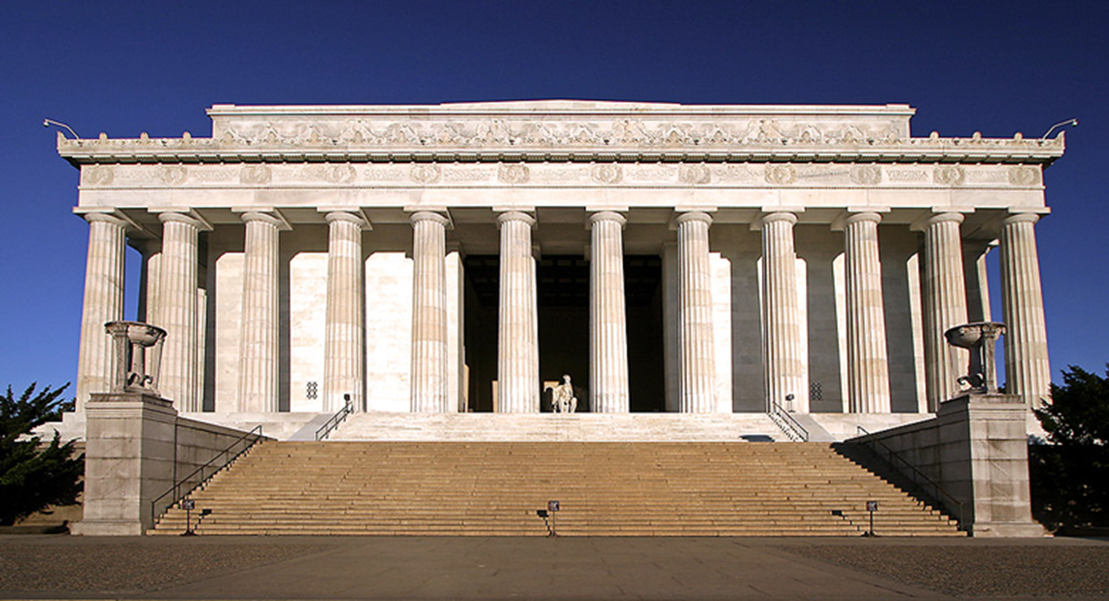
(1) Why was the Lincoln Memorial was deteriorating?
Because harsh chemicals were used to clean it

Slide 17
(2) Why were harsh chemicals being used to clean it?
To clean off the large amount of bird droppings

Slide 18
(3) Why so much bird poop?
Because large amounts of spiders live around the monument

Slide 19
(4) Why so many spiders?
Because vast swarms of insects, on which the spiders feed, are drawn to the monument at dusk

Slide 20
(5) Why are vast swarms of insects, on which the spiders feed, are drawn to the monument at dusk?
Because the lighting on the monument in the evening attracts the insects

Slide 21
Solution: Change how the monument is illuminated in the evening to prevent attraction of swarming insects

Slide 22
Question to Avoid in Customer Interviews
Do you think it’s a good idea?
Would you buy this product?
How much would you pay for it?
Would you pay $x for a product that did this?
Avoid hypothetical questions about the future, most people are overly optimistic. Instead, ask about past behaviors.

Slide 23
Should you still interview if?
You don't have a product yet?
You have this problem yourself and know the space well?
You already have customers?

Slide 24
Finding Customers to Interview
Figure out who are your target customers – group with the biggest pain points
Cold outreach - Social media, in-person, landing page, e-mail captures
"I am at Harvard doing research on {one sentence description} do you have 15 minutes to talk or 5 minutes for a survey?"
Start with 5 interviews, consolidate your learnings, and decide the next 5 you want to talk to.
Stop when you are no longer learning.

Slide 25
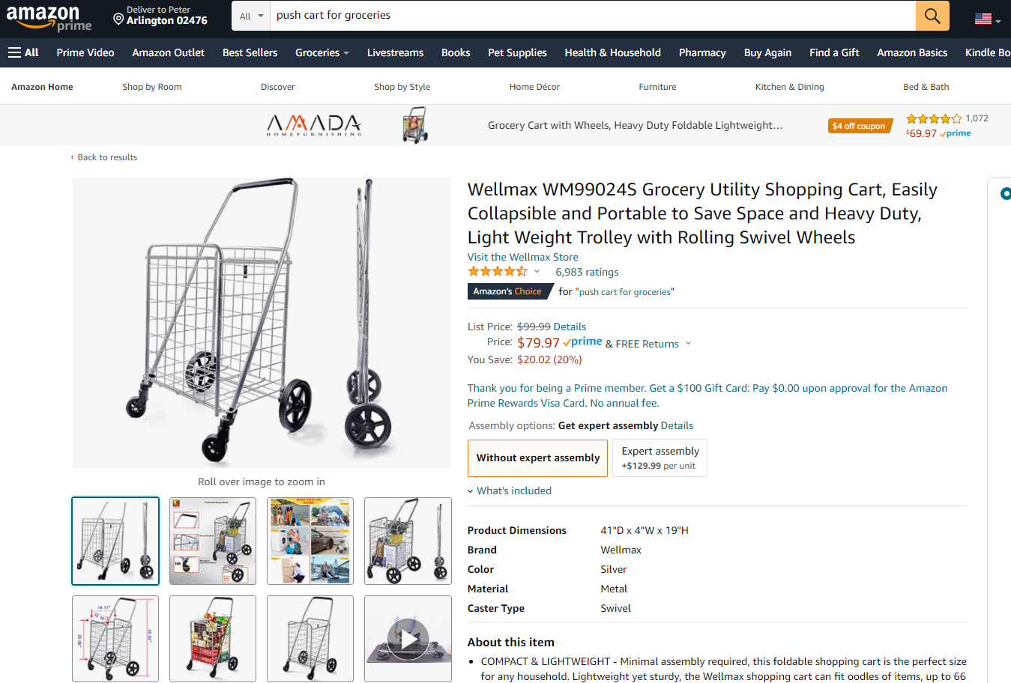
Is it all just Interviews? Review Competitive Feedback

Slide 26
Become an expert in the needs/behaviors of your Customers
Mass Hole Donuts – Customer Segments
 | Daily Commuter | Foodies | Celebrators | One-Timers
Description | Visit often, Spend little. Stop in on way to work. Monday – Friday. | Looking for fun culinary experience. Friday- Sunday. Typically a couple or a family | Catering a celebration for either work or family. | Big events. Weddings, Bar Mitzvahs, Engagement parties
Percent of Customers | 55% | 30% | 10% | 5%
Percent of Revenue | 25% | 40% | 15% | 20%
What’s most important to Them? | Fast and Fresh Service | Quality, Taste and Variety | Taste, Price, Ease of Ordering | Uniqueness and Quality
Most Effective Marketing Tactics | Coffee & Donut combo/Loyalty program | Changing weekly menu | Online ordering, Delivery, Large preset order options | Custom Flavors, Delivery, Venue coverage
How to Market to Them | Email, Loyalty Program​ | FB, Instagram, Brewery/Food festival Pop-ups​ | Email, FB, Instagram, Convert Daily Commuter and Foodies​ | FB, Instagram, Event Planners, Expos​

Slide 27
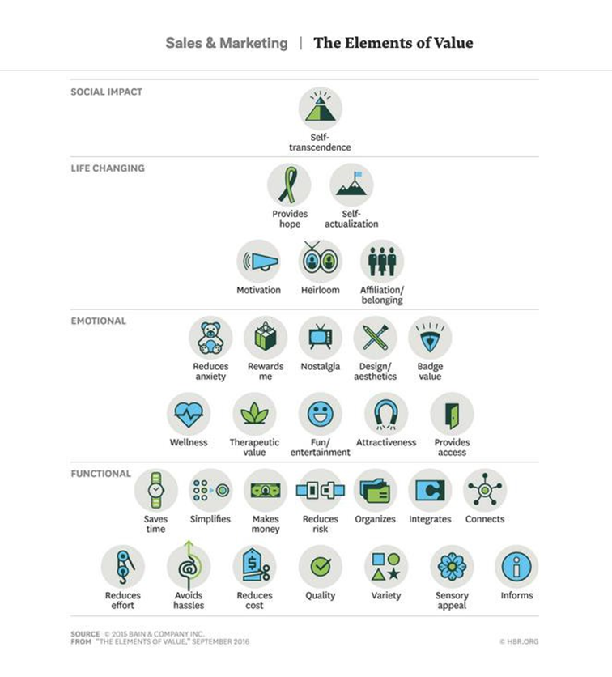
When are you ready to move on to the solution?
Do you know the root cause and the real value proposition?
Chose 3-5 top "hypothesis" value propositions

Slide 28
Exercise 1: Customer discovery journey
I need volunteers
Please share what you've done so far on customer discovery.
What are you doing well so far?
What have you learned?
What could you improve?

Slide 29
Step 2: Validating your Solution (or MVPs)

Slide 30
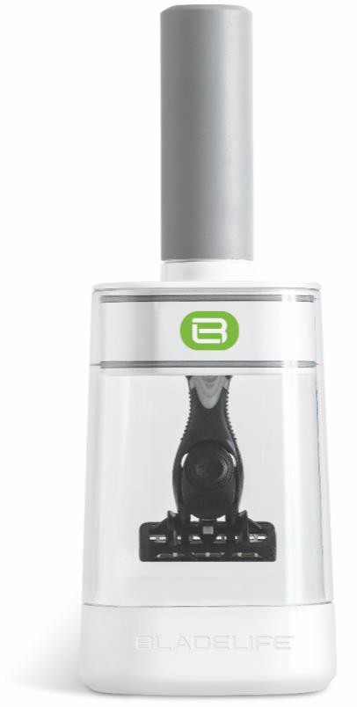
Example

Slide 31
What benefit will resonate the most?

Slide 32
What benefit will resonate the most?
Functional
Double the life of your blade
Cut your razor costs in half
Sanitary storage
Emotional
Cool way to store your razor

Slide 33
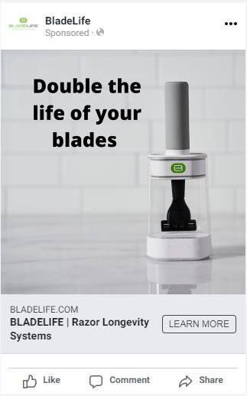
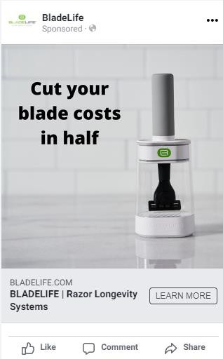
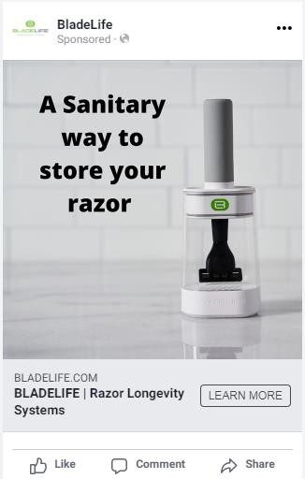
benefit test

Slide 34
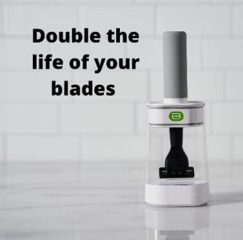
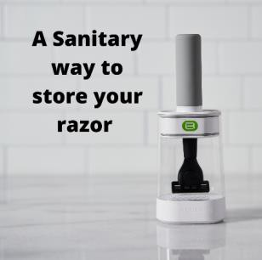
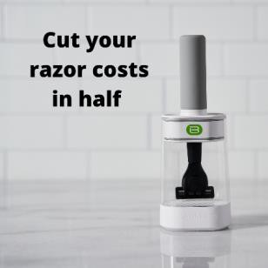
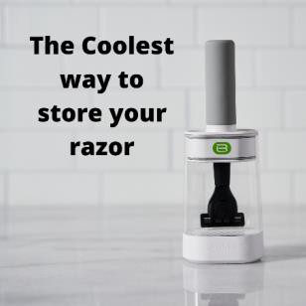
benefit test - Summary
 | Double Life | Sanitary | Cut Costs | Coolest Way
Spent | $92.41 | $62.28 | $93.61 | $145.58
Reach | 8,199 | 4,192 | 7,515 | 8,592
Clicks | 227 | 61 | 168 | 242
% Clicks | 2.8% | 1.5% | 2.2% | 2.8%
T

Slide 35
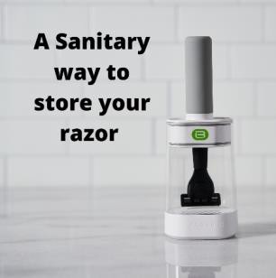
Don't make assumptions too early
 | Double Life | Sanitary | Cut Costs | Coolest Way
Men | 2.8% | 1.5% | 2.2% | 2.8%
General | 2.8% | 1.6% | 2.2% | 3.2%

Slide 38
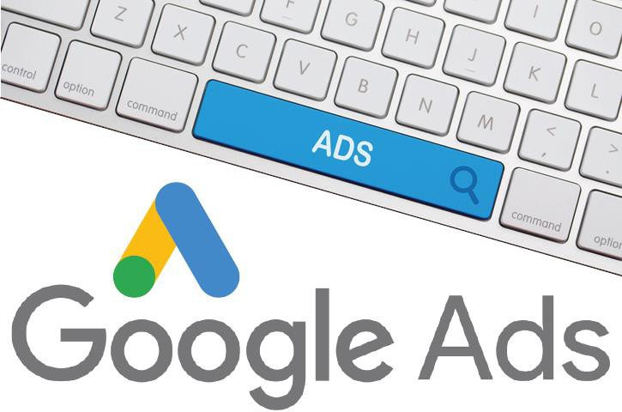
Or use other tools...to test click thru rates
Refining Your Idea
Remember: Go where THEY are
When people search for [words you choose], your ad comes up
You pay for results (clicks, calls)
Depending on your search its more or less $
You target by geography (or worldwide)
You set a budget cap, can pause anytime
You don’t need to have launched anything—you can direct people to a splash page with a waitlist
Lots of analytics

Slide 39
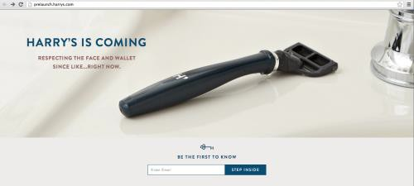
Splash Page with Waitlist
Refining Your Idea

Slide 40
Do this until landing customers is easy

Slide 41
Does Customer Validation end after Launch?

Slide 42
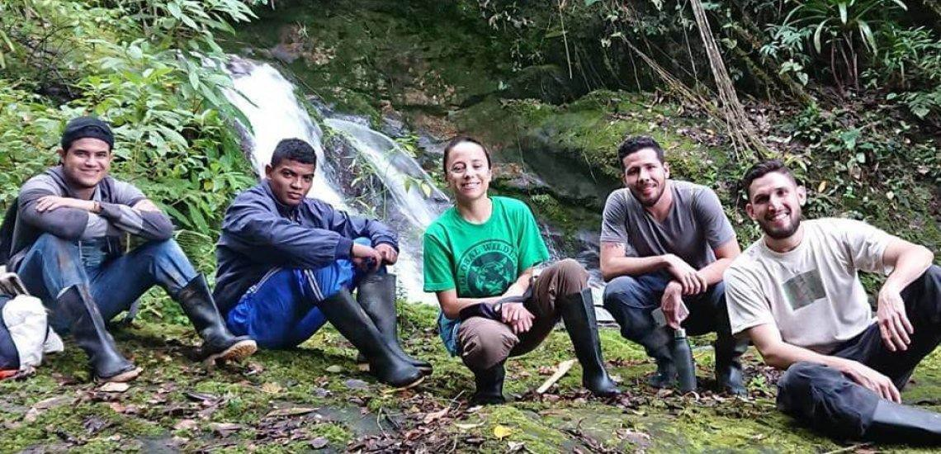
Who is the more desirable customer for a non-profit with a strong enviromental mission?
Environmentally conscious Millennials
Grandmothers

Slide 43
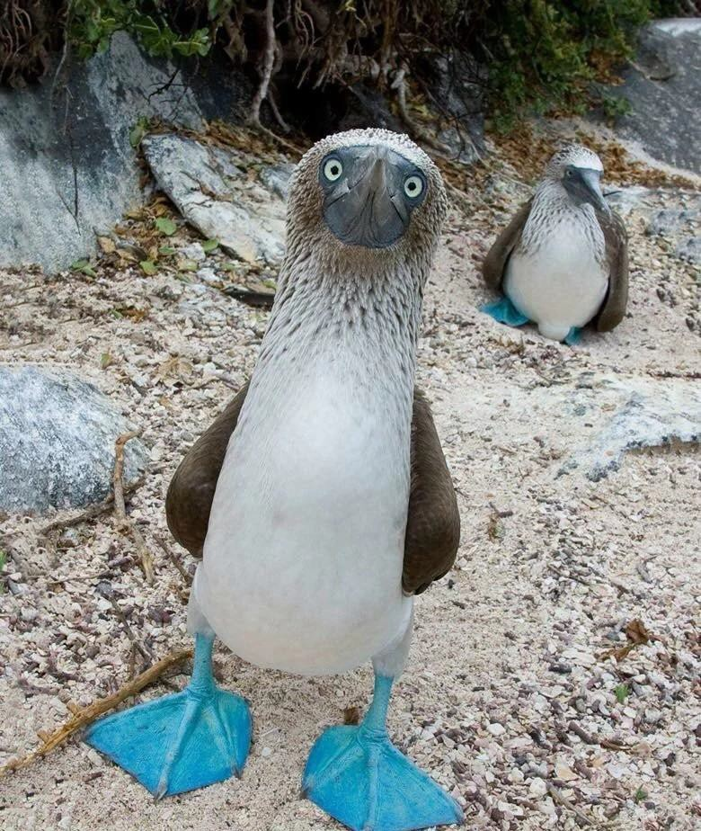
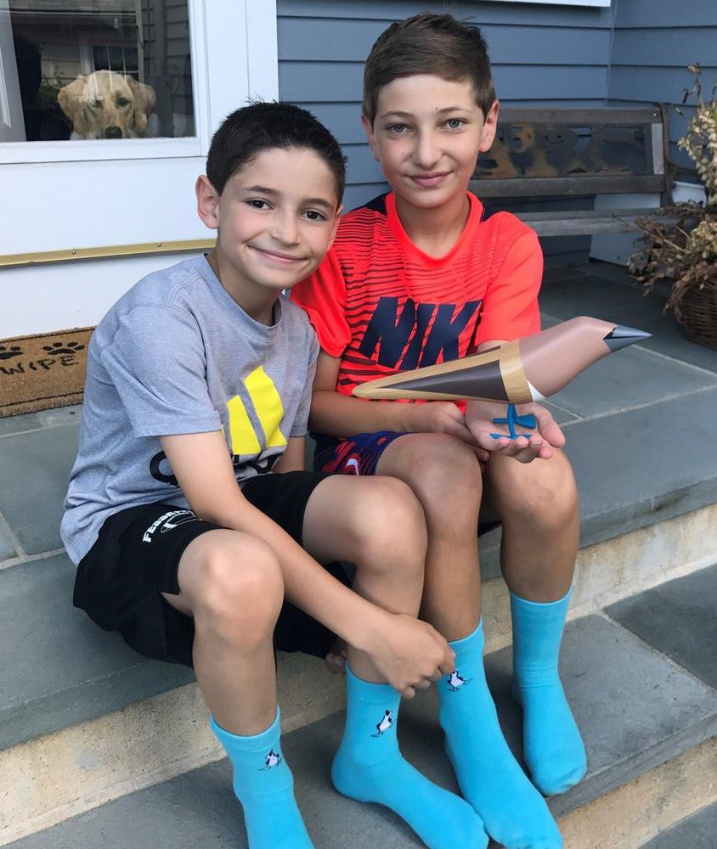
Case Study:
Blue Feet Foundation and who is the customer
Two brothers decide to sell blue socks to raise money for the blue- footed booby

Slide 44
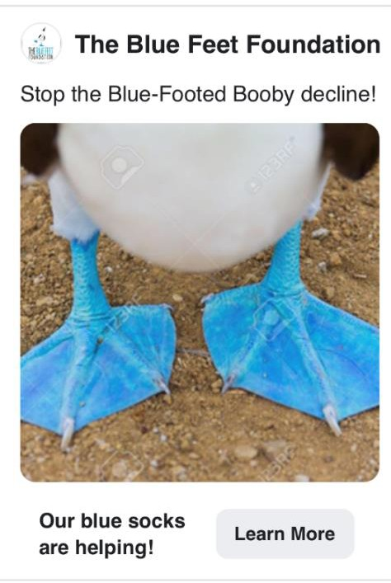
Case Study:
Blue Feet Foundation and who is the customer
Millennial Bird Lovers and Conservationists
Help save a special bird!
Target
Tactic
Create Instagram account to attract customers
Post facts and photos of the blue-footed booby and pictures of people wearing the socks

Slide 45
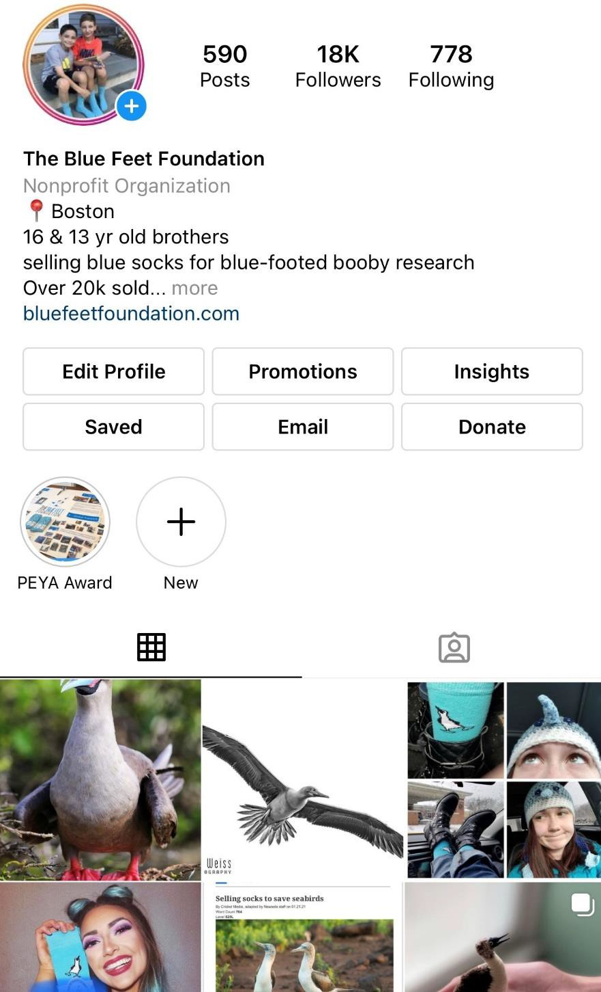
Case Study:
Blue Feet Foundation and who is the customer
Successfully attract social media followers
But no sales from digital ads?????

Slide 46
Case Study:
Blue Feet Foundation and who is the customer
Used Facebook to analyze existing customers to figure
out who the real customer was…..
+ =
Age
13-17 | 0%
18-24 | 3%
35-44 | 6%
45-54 | 19%
55-64 | 40%
65+ | 32%
 | 100%
Male | 20%
Female | 80%

Slide 47
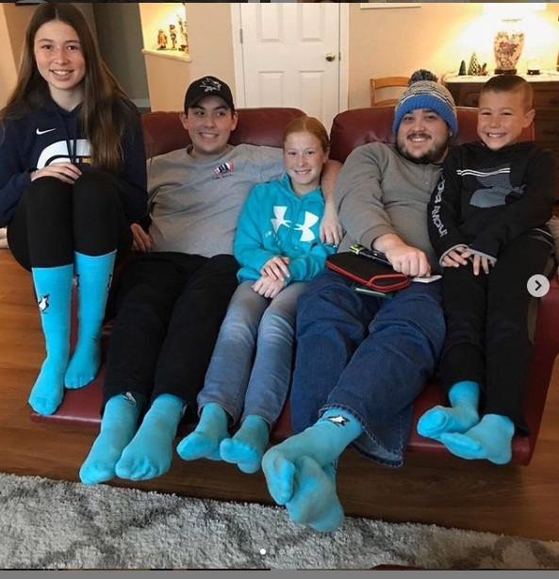
Case Study:
Blue Feet Foundation and who is the customer
Used Facebook to analyze existing customers to figure
out who the real customer was…..
+ =
Age
13-17 | 0%
18-24 | 3%
35-44 | 6%
45-54 | 19%
55-64 | 40%
65+ | 32%
 | 100%
Male | 20%
Female | 80%

Slide 48
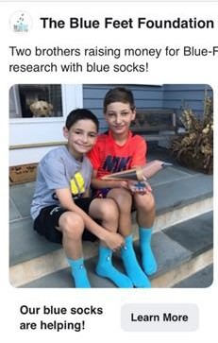
Case Study:
Blue Feet Foundation and who is the customer
Targeting the real customer:
1. Change primary messaging from Bird to Boys
1. Help save a special bird
2. Two boys trying to save a bird
Focus on Facebook not Instagram – Grandmothers are on FB not Instagram
Result: over 30,000 pairs of socks sold ($500K)

Slide 49
Exercise 2: Validating your offering
I need volunteers
How could you test your solution today without having it?

Slide 50
Summary
Become and expert in the problem you want to solve
Talk to people to who have the problem and understand their relationship to it
Test solutions until your customers tell you they want it
Develop the product

