Slide 1
Pitch Deck 102: Market Sizing, Go-To-Market, and Competitive Landscape
Phil Green & Pete Gladstone
Sr Advisors B2B & B2C, Harvard i-lab
Spring 2024

Slide 2
Agenda
Intro
Market Sizing
Competitive Landscape
Go-To-Market
B2B
B2C
Questions

Slide 3
Your Deck
What is the problem?
What is the solution?
What traction do you have
Customer vignette (make the problem come alive)
Is it a good business?
How big is the market?
What is the business model / GTM
How do you make money
How profitable can you be?
What is the competition?
What is your differentiation?
Can your team execute? (why is this the team to succeed)

Slide 4
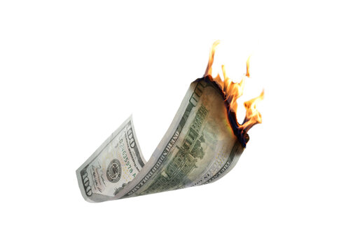
Your job – Influence the Investor's Mind
Will they burn my money in a fireplace?
Will they be the next Google?
Reduce the fear
Increase the FOMO
Notes:
Remember 90% of VC backed ventures fail within 10 yrs, which is the equivalent of burning the money in a fireplace.

Slide 5
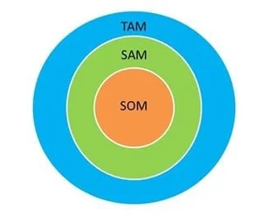
Market Sizing

Slide 6
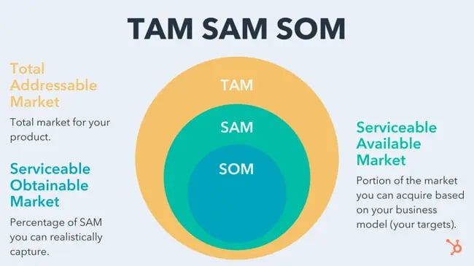
From: Hubspot

Slide 7
TAM (Total Addressable Market)
This represents the revenue opportunity that a company has if it has a full 100% of the market share, and there is no competition.
The total spend on this category
How to calculate
Top-Down Approach: Size of Industry (e.g. analyst reports / statista)
Bottom-Up Approach: total customers x price
Theory of Value (for big innovations): bottom-up with some estimates

Slide 8
SAM (Service Available Market)
This represents the “slice” of the TAM “pie” that can be served by a company’s products and services, or the actual amount of the market that might be served by the company’s products and services.
For example: due to the limitations of your business model (such as specialization or geographic limitations.
What part of the total market do you serve?

Slide 9
SOM (Serviceable Obtainable Market)
This represents the actual amount of the market that you hope capture with the company’s products and services.
What part of the market can you realistically capture?
DO NOT SAY X% market share (this is lazy)

Slide 10
Example: Two-sided Wedding Marketplace
TAM
2.5 M weddings in US
On average they spend $35,000 (pre-wedding + wedding + honeymoon)
TAM = $87 Billion
SAM
250k of these weddings are high-end, spend > $100,000
SAM = $25 Billion
SOM
Targeting high-end weddings served by 5000 planners (10 / year)
We can capture 2,000 of these in 3 years via our direct sales efforts
SOM (10% take rate on $2.0 B spend) - $200 Million

Slide 11
Competitive Landscape

Slide 12
Why do Investors Care?
"I’ve seen many competition slides that look all alike and tell me nothing of value.”
Investors are looking for things from a competition slide:
A clear overview of the Market
To see how much the founder knows their market
A quick education to see if the opportunity is worth investing in
Investors want a realistic overview of the market - Consider these questions:
Who are the key players – both big and established and small and innovative?
What are the competitors’ and startup's strengths and gaps?
What are the current alternatives to the startup’s solution?
A product with "no competition" is a sign to investors that there is no market or demand for the solution being offered.
It is also an indication that the founder likely hasn’t done enough homework.

Slide 13
Competition Slide Watch Outs
Investors expect founders to know everything that needs to be known about their competition. This is simply not limited to features and benefits. Investors firmly believed that founders need to know their competitor's business model, pricing, and funding history.
A feature is not a sustainable differentiator. With some money and resources, every competitor could replicate your oh-so-great features.
Comparing by features is the right thing to pitch to customers, but a VC wants to know what your sustainable key differentiators are. Technology, positioning, brand, a unique Go-To-Market strategy, team, etc. could be sustainable differentiators.
Focus on the benefit and the value that the solution offers.

Slide 14
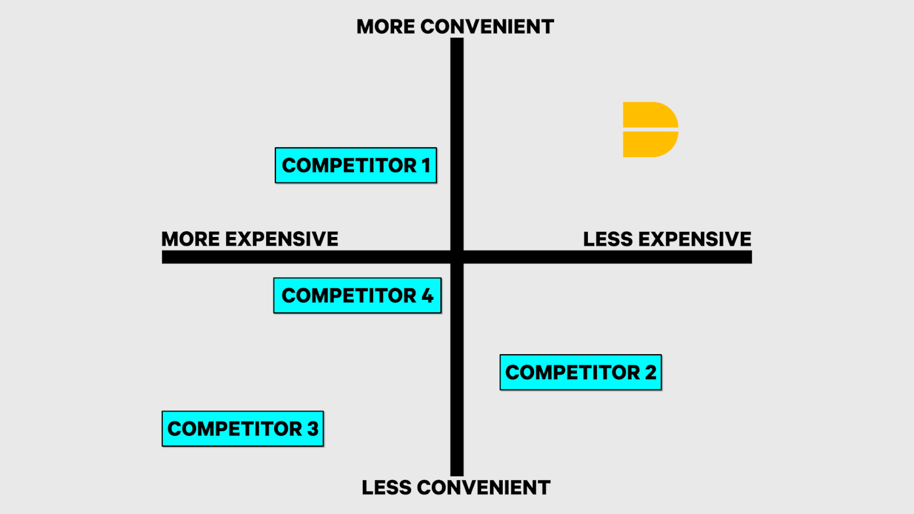
Bring Competition to Life
The Quadrants
The most common
2X2 grid plotting venture Vs competitors on two variables
Pros: Easy to digest, Makes you look special, Familiar
Cons: Superficial, Top right is expected, Self-Serving
Watch outs: equally weights competitors, invites skepticism
Use it to show how much you know about your customer (benefits) and why you meet their needs differently

Slide 15
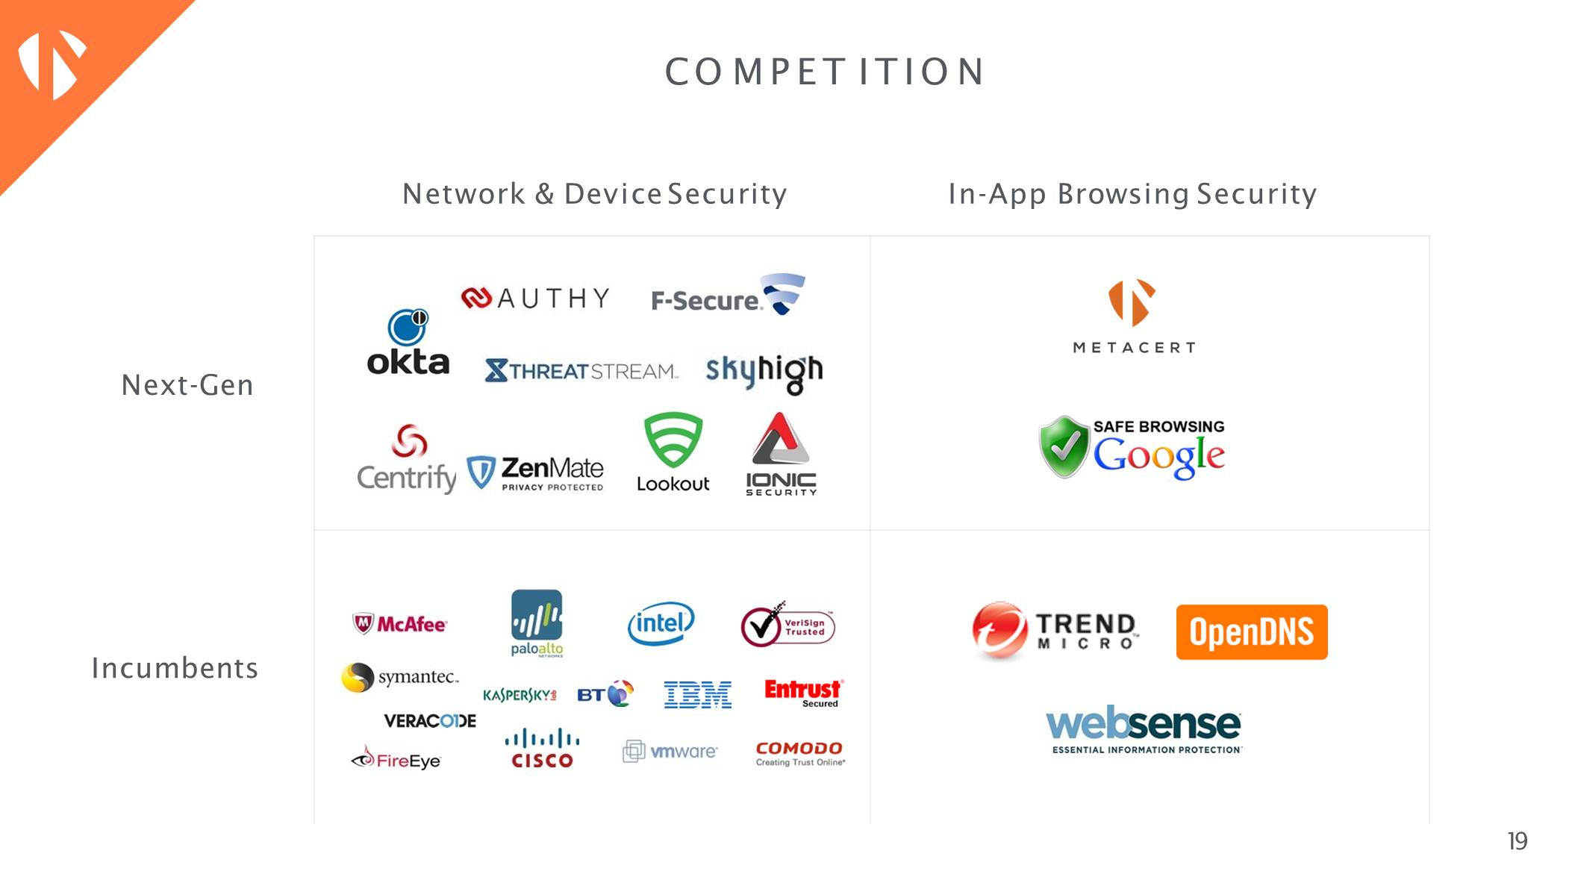
Bring Competition to Life – The Quadrants

Slide 16
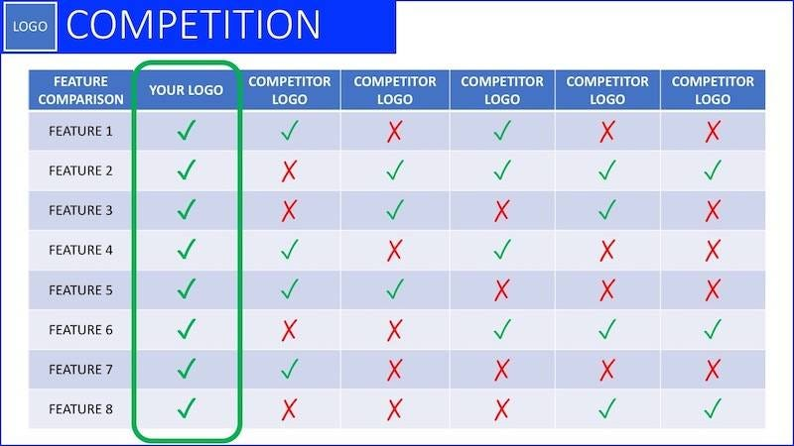
Bring Competition to Life
The Matrix
Very common
Matrix comparing features (& Benefits) with X's and Checkmarks
Pros: Allows for detailed differentiation, familiar
Cons: Can get messy, Hard to know importance of features, binary, self-serving
Watch outs: Investors don’t care about features as a competitive advantage, Can make business look complicated, Makes all features equal in importance
Use it to show how much you know about your customer (benefits) and why you meet their needs differently

Slide 17
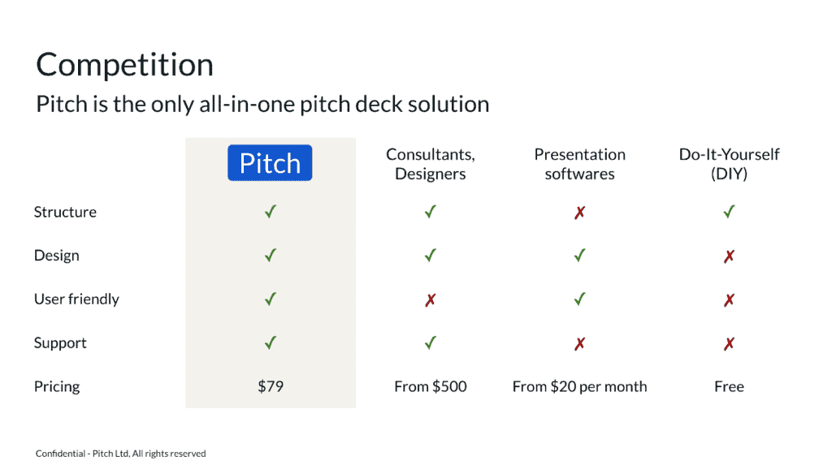
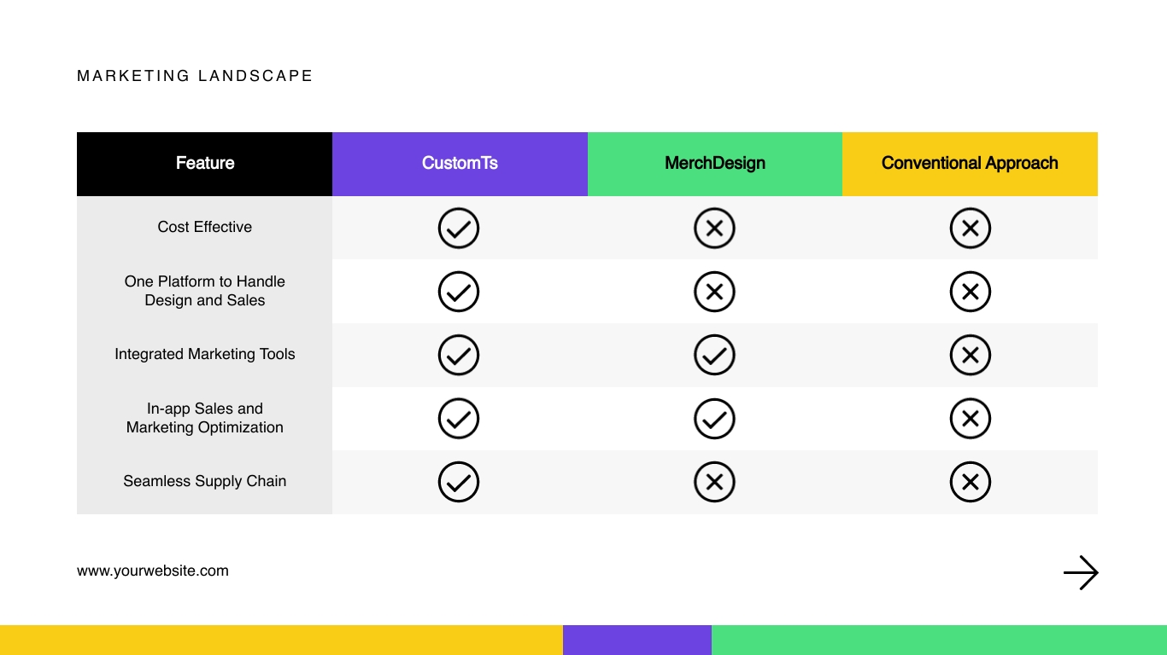
Competitive Matrix

Slide 19
Bring Competition to Life
The Status Quo
Less Common
Position yourself vs current customer behavior with current solutions instead of individual ventures
"The real competition is — and always will be — the status quo. Every entrepreneur who tries to expertly map their competition is making a fundamental mistake about why people use products. People don’t wake up in the mornings and think: “I want to buy a new product today.” They wake up and start triaging each problem as it arrives, one-by-one, until they go to bed."
“There is another possible perspective to look at the competition: Do you know who your biggest competitor is? Even if you’re the first mover in a market and there is still no second mover, you have that one, big villain: The Status Quo. Never forget how hard it is to convince humans to change their behaviors and to try something new. Your biggest enemy is The Status Quo – how your target groups are satisfying their needs today.”

Slide 20
Differentiation - vs Status Quo

Slide 21
Final Thought on Competition Slide
Even if you’re the best on your slide use this as an opportunity to really talk openly about what you believe customers want and why you believe your solution will help you succeed in the long run.
Say why you’ve chosen to be strong in certain areas — these being the ones you believe your target customers care about the most — and how you will develop other features to match competition in the future.

Slide 22
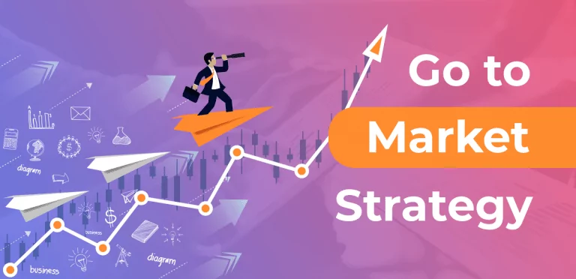

Slide 23
Don’t do this
Social Media
Google/Facebook/LinkedIn Ads
Direct Sales
Influencer Marketing
Freemium offering
Network effects & Virality
Telesales

Slide 24
Don’t do this
Social Media
Google/Facebook/LinkedIn Ads
Direct Sales
Influencer Marketing
Freemium offering
Network effects & Virality
Telesales
We do not know how to reach and convert customers

Slide 25
B2B

Slide 26
Elements
How do you reach customers? What is the most effective method?
Direct sales?
LinkedIn Ads?
Email (e.g. Apollo)?
How do you convert them to customers?
Direct Sales? Telesales?
Freemium? Pilot program?
What is the Churn and how long to they remain customers?
What is the CAC (customer acquisition cost)?
What is the LTV (lifetime value of customer)?

Slide 27
B2C

Slide 28
The Secret to a great go-to-market plan
90% of the growth in early start-ups came from 10% of what they tried;
early growth comes from a few very successful tactics
Experimentation to find the best growth levers (go-to-market strategy is all about pulling these levers)
Airbnb – wrote a script to automatically post new listings on Craigslist bringing them loads of free qualified renters
PayPal – wrote a script to message Ebay sellers, pretending to be buyers asking if they accept PayPal
Canva – had the insight many basic design tasks started with Google searches like “Certificate template” so they created thousands of SEO-Optimized pages with design templates and tutorials
Facebook and LinkedIn created onboarding processes that prompted new users to invite friends
Soy Milk – Located in refrigerated section next to milk even though it didn’t need to be refrigerated

Slide 29
Start with Growth Model with Drivers:
Weekly Active Listeners
Time Spent listening
Revenue
Outcomes:
Listeners
Content
Access
Key Drivers:
Traffic
Conversion
Landing page copy
Current Catalogue
High quality audio
Paid
Levers/Actions:
App
SEO
Sign up flow
Deep Catalogue
Referral
Podcasts
Web
Traffic Quality
OfflIne
Social
Incentives
Live Events

Slide 30
Growth Model with Drivers:
Weekly Active Listeners
Time Spent listening
Revenue
Outcomes:
Listeners
Content
Access
Key Drivers:
This is your go-to-market strategy
Traffic
Conversion
Landing page copy
Current Catalogue
High quality audio
Levers/Actions:
Paid
SEO
Sign up flow
Deep Catalogue
App
Referral
Podcasts
Web
Traffic Quality
OfflIne
Social
Incentives
Live Events

Slide 31
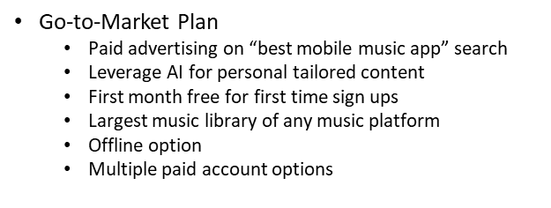
Be specific when communicating your Go-To-Market

Slide 32
Q & A

